Slide 1

Pwning AWS Infrastructure Services
Suraj Khetani
Twitter - @funkyfreestyler

Slide 2
Agenda
AWS Fundamentals (Boring Stuff)
Understanding AWS Services
Managing Users and Roles in AWS (IAM)
Hunting and Abusing misconfigured S3 buckets
Attacking EC2 Instances
Securing AWS Infrastructure

Slide 3
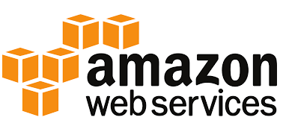
AWS Fundamentals
Global Infrastructure

Slide 4
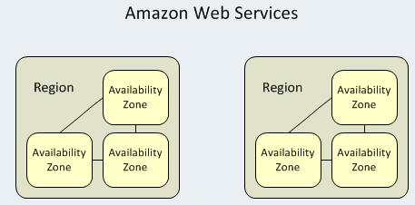
AWS Global Infrastructure
AWS Availability Zone An AZ is a combination of one or more data centers in a given region. Interconnected with Hi-Speed LAN for fast communication between availability zones within the same region. Systems can span multiple AZ Eg: ap-northeast-1a, ap-northeast-1b, ap-northeast-1c, eu-central-1a, eu-central-1b Services: EC2, EBS volumes, RDS Instance
AWS region An Amazon AWS region is a physical location spread across globe to host data to reduce latency. Each region has at least two availability zones for fault tolerance. Data is not replicated outside of a specified region. Ability to build and store data across multiple regions Eg: ap-northeast-1, eu-central-1 Services: S3Buckets, VPC, EC2/RDS snapshot
AWS Edge location An edge location is where end users access services located at AWS. Act as gateways between AWS regions and the internet when incorporated in to a workload design. Chennai, India, Hong Kong, China (2), Melbourne, Australia, Mumbai, India,Osaka, Japan, etc Services: Amazon CloudFront and Route53, IAM Entities (Users, Roles, Groups, Policies

Slide 5
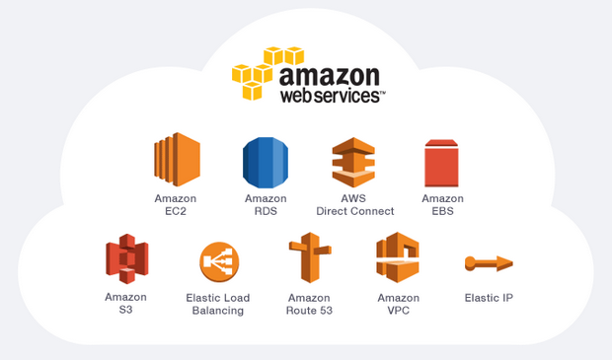
Understanding AWS Services

Slide 6







Understanding AWS Services
 | EC2 (Elastic Cloud Compute) - VMs on the cloud with SSH / RDP instances
 | S3 (Simple Storage Service) buckets - Storage repository for uploading and downloading data similar to a file server
 | EBS (Elastic Block Storage) - Similar to partitions on a computer
 | RDS (Relational Database Service) - Databases on the cloud
 | ELB (Elastic Load Balancers) - Load balancers on cloud
 | VPC (Virtual Private Cloud) - Networks on cloud
 | Lambda - Allows one to run code without managing servers

Slide 7

Managing Users and Roles(IAM)
Understanding Users and Roles Creating IAM Users and Roles Using AWS CLI

Slide 8
Managing AWS users and roles
Identities (Users, Groups, and Roles)
Users
Root Account
The primary AWS account is very powerful in terms of access
IAM Admin Account
To avoid losing its keys or secrets, an IAM Administrator account is created which will have the same privileges as a AWS root account except for access to certain features like billing.
IAM User Account
Similar to the admin account but has less privileges
IAM Groups
An IAM group is a collection of IAM users.

Slide 9
Managing AWS users and roles
IAM Role
Very similar to a user, in that it is an identity with permission policies that determine what the identity can and cannot do in AWS.
A role does not have any permanent credentials (password or access keys) associated with it.
Temporary credentials are primarily used with IAM roles
Use cases of an IAM role:
You're creating an application that runs on an EC2 instance and that application makes requests to AWS.

Slide 10
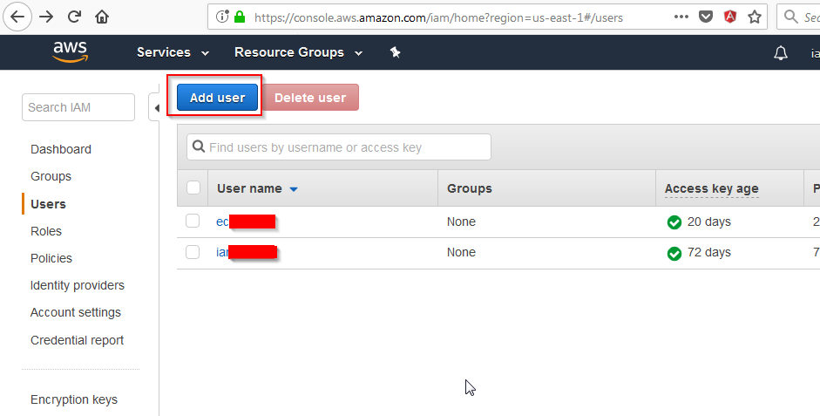
Creating IAM User

Slide 11
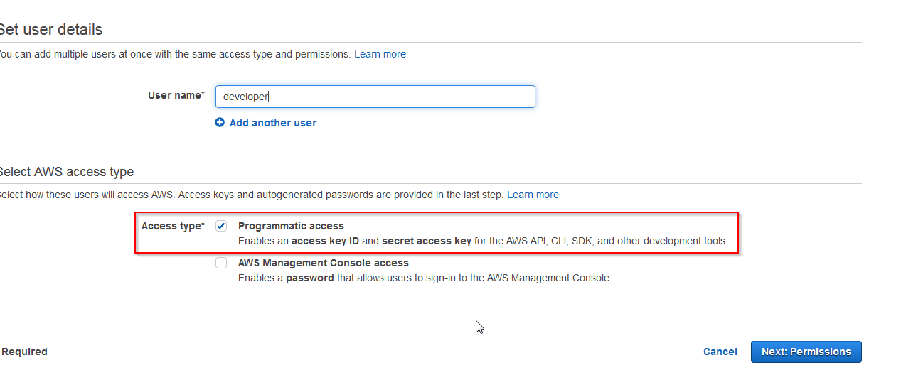
Creating IAM User

Slide 12
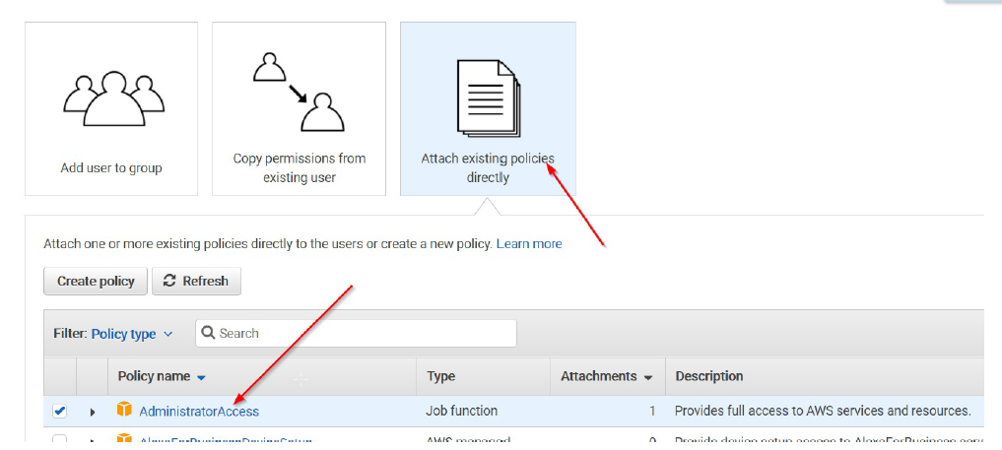
Creating IAM User

Slide 13
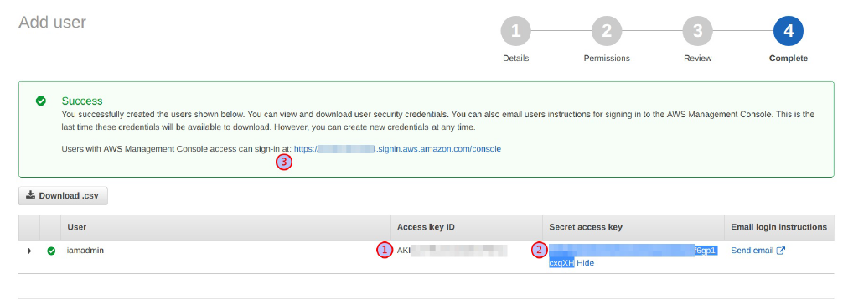
Creating IAM User
Access key ID
Secret access key
Unique sign in URL (Bookmark this link)

Slide 14
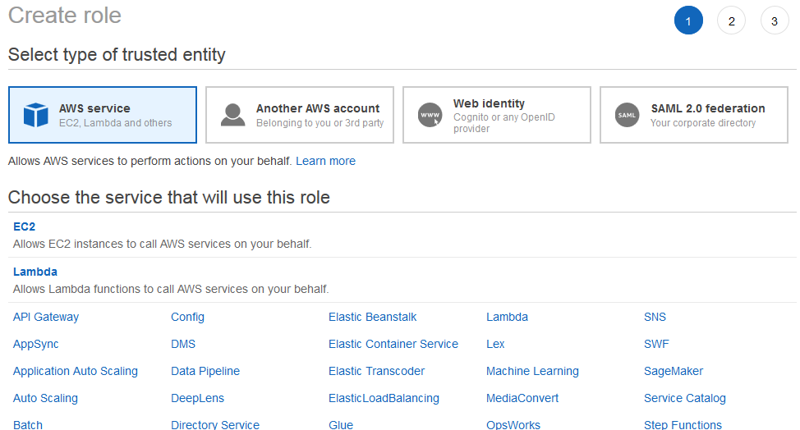
Creating IAM Roles

Slide 15
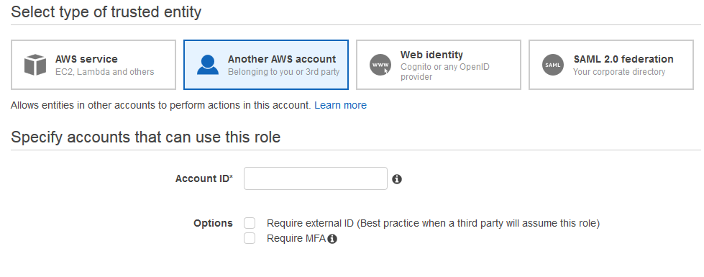
Creating IAM Roles

Slide 16
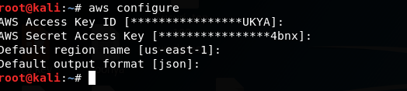
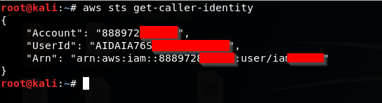
AWS CLI
AWS CLI – tool to manage AWS services
Configuring access via aws cli
Checking status

Slide 17

Hunting and Exploiting S3 buckets
S3 Theory
Recon, Recon, and Recon

Slide 18
Hunting and Abusing S3 buckets
Files stored in an S3 bucket are called objects
By default, only bucket and object owners have access to the resources
Permissions can be given per object and per bucket.
Use Cases:
Can be used as a platform for serving assets such as images and Javascript.
Can be used for complete server backups to the cloud.
Can be used for hosting static websites.
Common vulnerabilities in S3:
Unauthenticated Bucket Access - allows anonymous users to list, read, and or write to a bucket.
Semi-public Bucket Access - allows any AWS authenticated user i.e. with a valid AWS access key and secret to list, read and or write to a bucket.
Improper ACL Permissions - may reveal which users have what type of access.

Slide 19
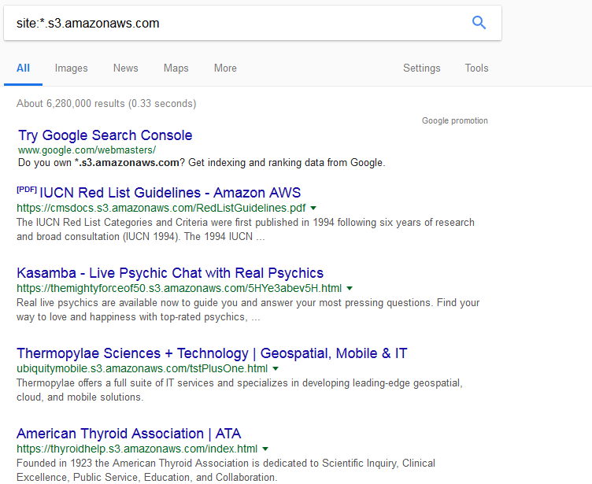
Hunting and Abusing S3 buckets
S3 buckets google dorks:
site:*.s3.amazonaws.com

Slide 20
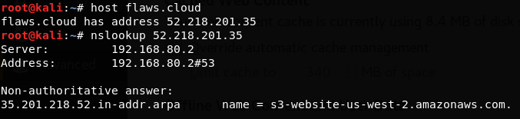
Hunting and Abusing S3 buckets
nslookup

Slide 21
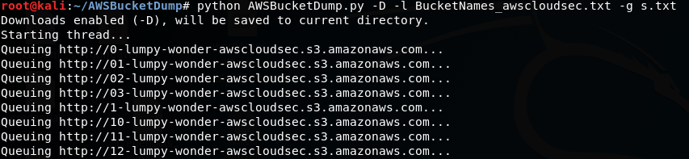
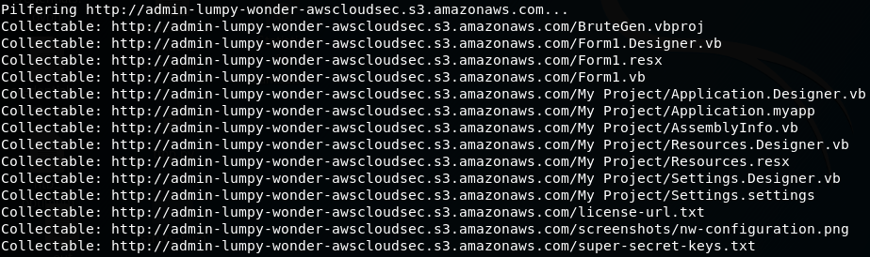
Hunting and Abusing S3 buckets
Bruteforce with AWSBucketDump
python AWSBucketDump.py -D -l BucketNames_awscloudsec.txt -g s.txt

Slide 22
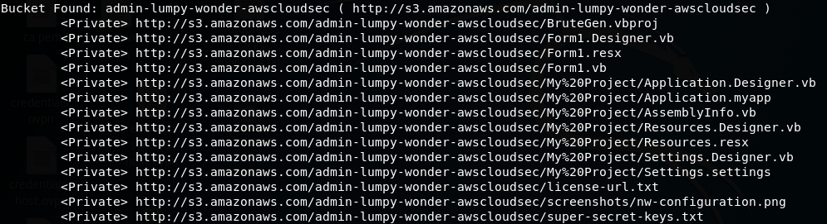
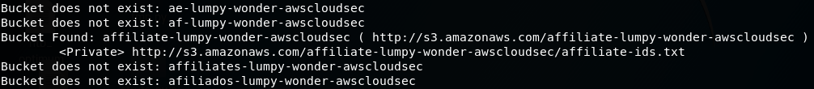
Hunting and Abusing S3 buckets
Using bucket-finder to list permissions
Checks to see if the bucket is public, private or a redirect
ruby bucket_finder.rb BucketNames_awscloudsec.txt

Slide 23
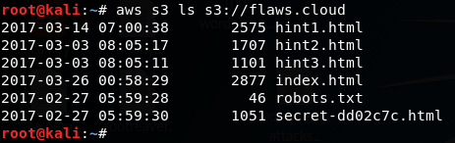
Hunting and Abusing S3 buckets
Accessing S3 buckets with aws cli
aws s3 ls s3://<bucket_name> - will list buckets
aws s3 cp s3://<bucket_name> <name_of_file> - will download file from the bucket
aws s3 mv s3://<bucket_name> <name_of_file> - will upload a file to the bucket

Slide 24
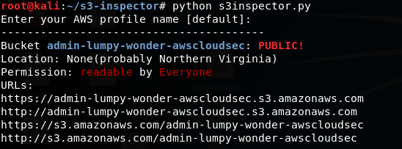
Hunting and Abusing S3 buckets
Auditing s3 buckets with s3-inspector
Checks all your buckets for public access
For every bucket gives a report with:
Indicator if your bucket is public or not
Permissions for your bucket if it is public
List of URLs to access your bucket (non-public buckets will return Access Denied) if it is public

Slide 25
Attacking EC2 Instances
EC2 instance attack surface
Understanding and Abusing EC2 Metadata
Brute-forcing EC2 instances

Slide 26
Attacking EC2 Instances
Attack surface
EC2 Metadata abuse
Brute-forcing SSH/RDP password
Leaked SSH private keys

Slide 27
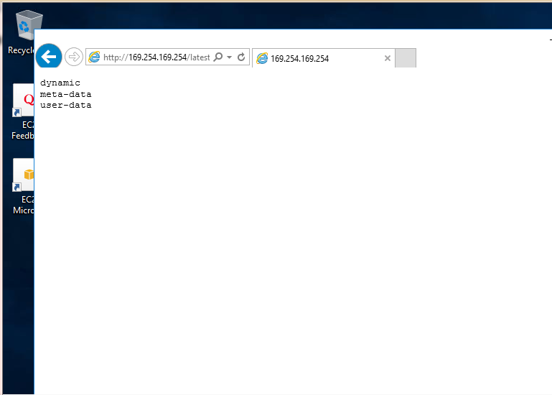
Attacking EC2 Instances
EC2 Metadata
Data about your instance that can be used to configure or manage the instance. Contains the following information:
Local IP Address
User-­data
Instance profile: AWS API credentials
Accessible via http://169.254.169.254/

Slide 28
Attacking EC2 Instances
EC2 Metadata Cont.
Why is meta-data needed?
Needed for auto-scaling the EC2 instance and more
What is user-data?
Once an IAM role is attached, the user-data is available along with the meta-data
Why is user-data needed?
An application hosted on the EC2 instance may need privileges to get data from an S3 bucket.
Anyone who can access the instance can access the meta-data

Slide 29
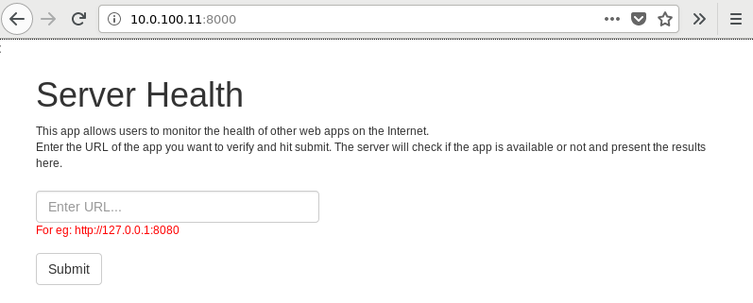
Attacking EC2 Instances
Gaining access to EC2 metadata using SSRF

Slide 30
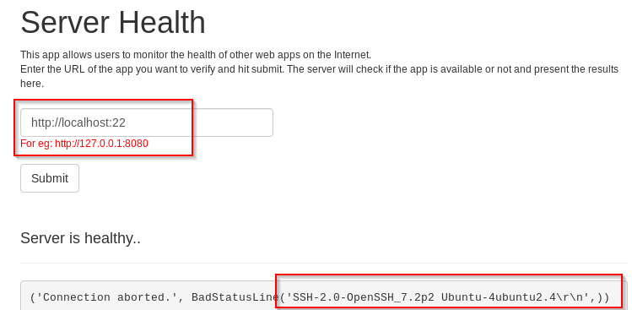
Attacking EC2 Instances
Gaining access to EC2 metadata using SSRF

Slide 31
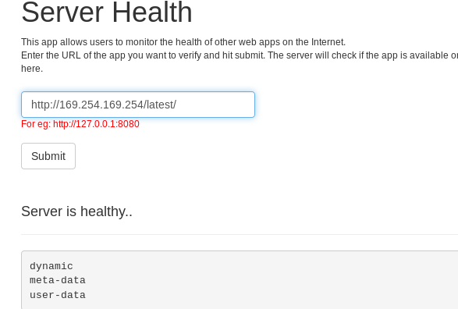
Attacking EC2 Instances
Gaining access to EC2 metadata using SSRF

Slide 32
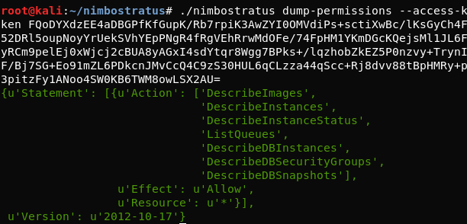
Attacking EC2 Instances
Nimbostratus: Tool for fingerprinting and exploiting Amazon cloud infrastructures.
Using Nimbostratus for dumping permissions
./nimbostratus dump-permissions --access-key ....... --secret-key ....... --token .......

Slide 33
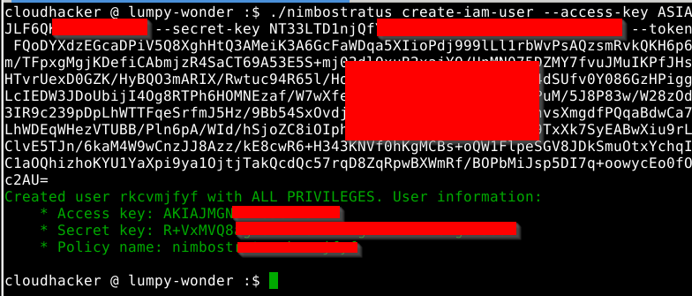
Attacking EC2 Instances
Using Nimbostratus for creating IAM user
./nimbostratus create-iam-user --access-key ........ --secret-key ........ --token ........

Slide 34
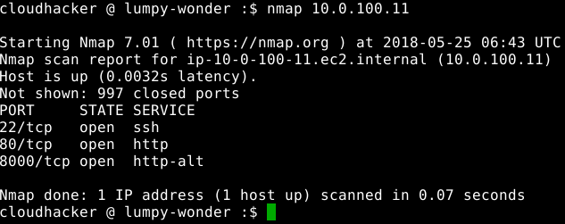
Attacking EC2 Instances
Brute-forcing SSH/RDP Services
nmap to find services

Slide 35
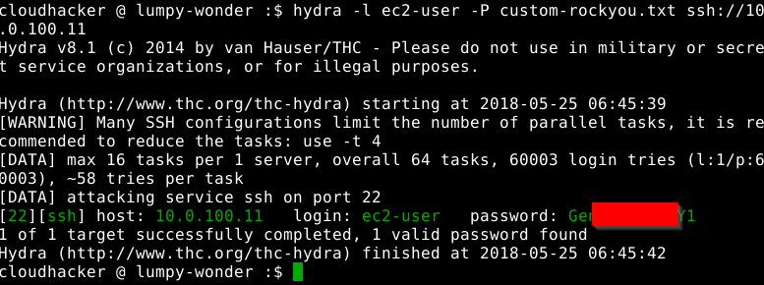
Attacking EC2 Instances
Brute-forcing SSH/RDP Services
hydra -l ec2-user -P rockyou.txt ssh://10.0.100.11

Slide 36
Attacking EC2 Instances
Leaked SSH keys or Secrets on GitHub, Gitlogs, Pastebin, S3 buckets, etc

Slide 37
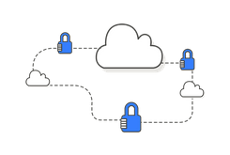

Building a Secure AWS Infrastructure

Slide 38
Building a Secure AWS Infrastructure
Use IAM instead of your root account
Use IAM generated users with fine grained permissions instead of using the root account credentials from within your EC2 instances.
Different users for different tasks
Assign the least possible privilege for each of the instance profiles and users. Split the users into groups and manage fine­-grained permissions for each.
Use instance profiles
Instance profiles are the safest and simplest way to provide AWS credentials to EC2 instances. The risks associated with other solutions such as hard­ coding credentials in the (web) application source code are even higher than the ones instance profiles have.

Slide 39
References and Recommended Articles
https://www.blackhat.com/docs/us-14/materials/us-14-Riancho-Pivoting-In-Amazon-Clouds-WP.pdf#tools
https://summitroute.com/blog/2017/08/13/defensive_options_when_using_aws_iam_roles/
https://blog.christophetd.fr/abusing-aws-metadata-service-using-ssrf-vulnerabilities/
https://rhinosecuritylabs.com/penetration-testing/penetration-testing-aws-storage/
https://rhinosecuritylabs.com/cloud-security/onelogin-breach-cloud-security-and-protecting-aws-ami-keys/
https://www.virtuesecurity.com/blog/aws-penetration-testing-s3-buckets/
https://rhinosecuritylabs.com/cloud-security/aws-security-vulnerabilities-perspective/
https://www.virtuesecurity.com/blog/aws-penetration-testing-part-2-s3-iam-ec2/
https://blog.detectify.com/2017/07/13/aws-s3-misconfiguration-explained-fix/
https://www.linuxnix.com/amazon-aws-regions-vs-availability-zones-vs-edge-locations-vs-data-centers/

Slide 40
Topics for Next session
Attacking AWS Lambda Endpoints
Abusing public EBS snapshots
Attacking RDS instances
OSINT Techniques on cloud
Auditing and Monitoring AWS infrastructure

Slide 41


